Slide 1

P peline
The Data
Visualizing Big Data
© Jennifer Mankoff
The Data Pipeline; HCII; Spring 2014

Slide 2
Visualizing Big Data
First a tour
Then some techniques
http://www.smashingmagazine.com/2007/08/02/data-visualization-modern-approaches

Slide 3
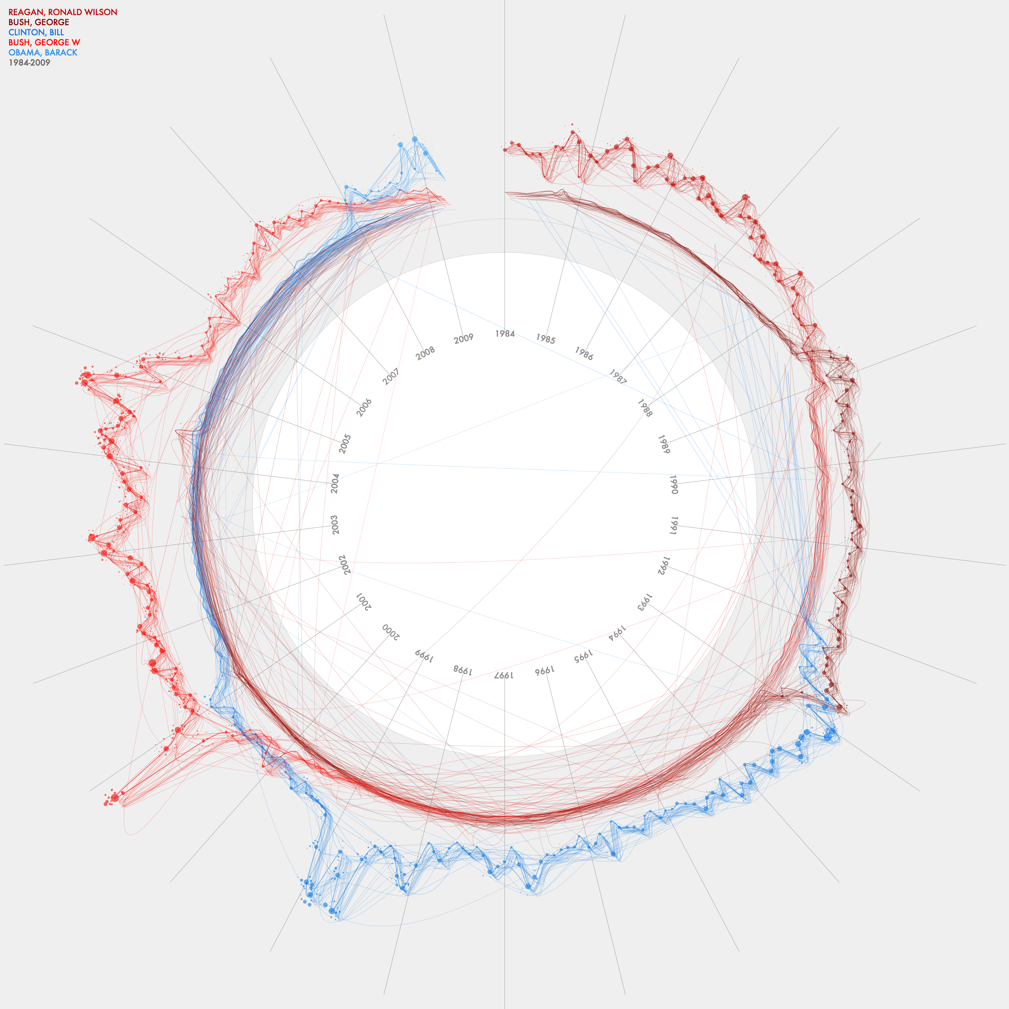
Jer Thorp
Data Artist
This graph charts the frequency of mention of the five US Presidents between 1984 and 2009. It also indicates weighting of stories - the darkest line shows front page stories while the lighter lines indicate stories buried deeper in the paper.
Built with Processing, v. 1.0
blog.blprnt.com

Slide 4
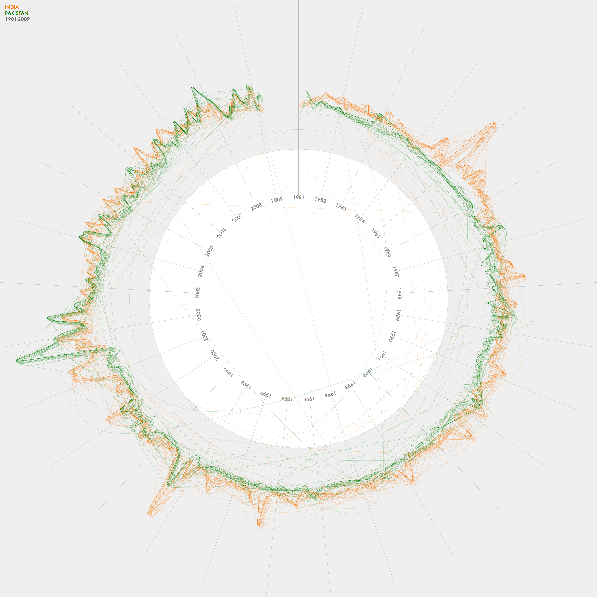
Jer Thorp
Data Artist
NYTimes Threads - India & Pakistan
This graph charts the frequency of articles mentioning India and Pakistan in the NYT between 1981 and 2009. It also indicates weighting of stories - the darkest line shows front page stories while the lighter lines indicate stories buried deeper in the paper.

Slide 5
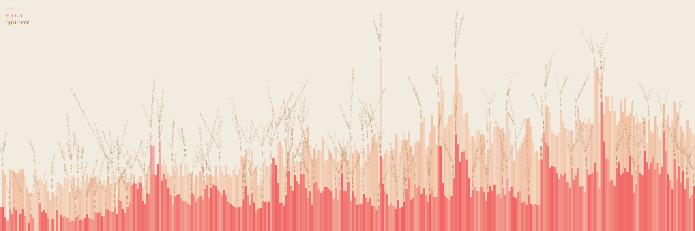
Jer Thorp
Data Artist
NYTimes: Sex & Scandal since 1981
This is a visualization of the frequency of occurrence of the words 'sex' and 'scandal' in the New York Times, since 1981.
See how many times you can count the words 'catholic church'.

Slide 6
Jer Thorp
Data Artist
NYTimes: Sex & Scandal since 1981
This is a visualization of the frequency of occurrence of the words 'sex' and 'scandal' in the New York Times, since 1981.
See how many times you can count the words 'catholic church'.

Slide 7

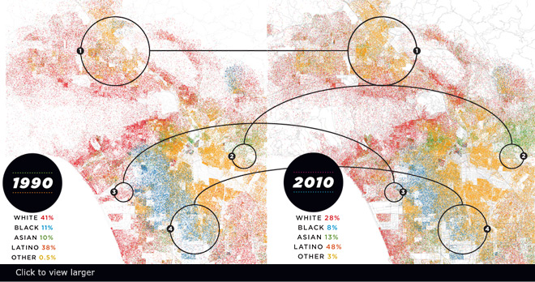
Race in LA (Eric Fischer)
Nice narrative @lamag.com http://www.lamag.com/features-hidden/race-in-la-see-how-weve-grown/#0412infographic
Notes:
1. Most highly concentrated in the north San Fernando Valley, Latinos are now the region’s largest ethnic group.
2. With 47% of its population of Chinese descent, Monterey Park is the first mainland American city to have an Asian majority.
3. An empty industrial relic in 1990, Playa Vista is now one of L.A.’s most racially and ethnically diverse communities.
4. African Americans continue to leave South L.A. Compton is now 65% Latino, though there are no Latinos on the city council.
- See more at: http://www.lamag.com/features-hidden/race-in-la-see-how-weve-grown/#0412infographic

Slide 8
World travel and communications recorded on Twitter
Green is physical movement from place to place; purple is @replies from someone in one location to someone in another; combining to white where there is both.
Reported trips to Null Island excluded; all other geotags trusted. Endpoints of trips are real data; routes in between are fabricated. Brightness is logarithmic.
Data from the Twitter streaming API through September 1, 2011. Continent shapes from Natural Earth. Author: Eric Fischer https://www.flickr.com/photos/walkingsf/6635655755/in/photostream/

Slide 9
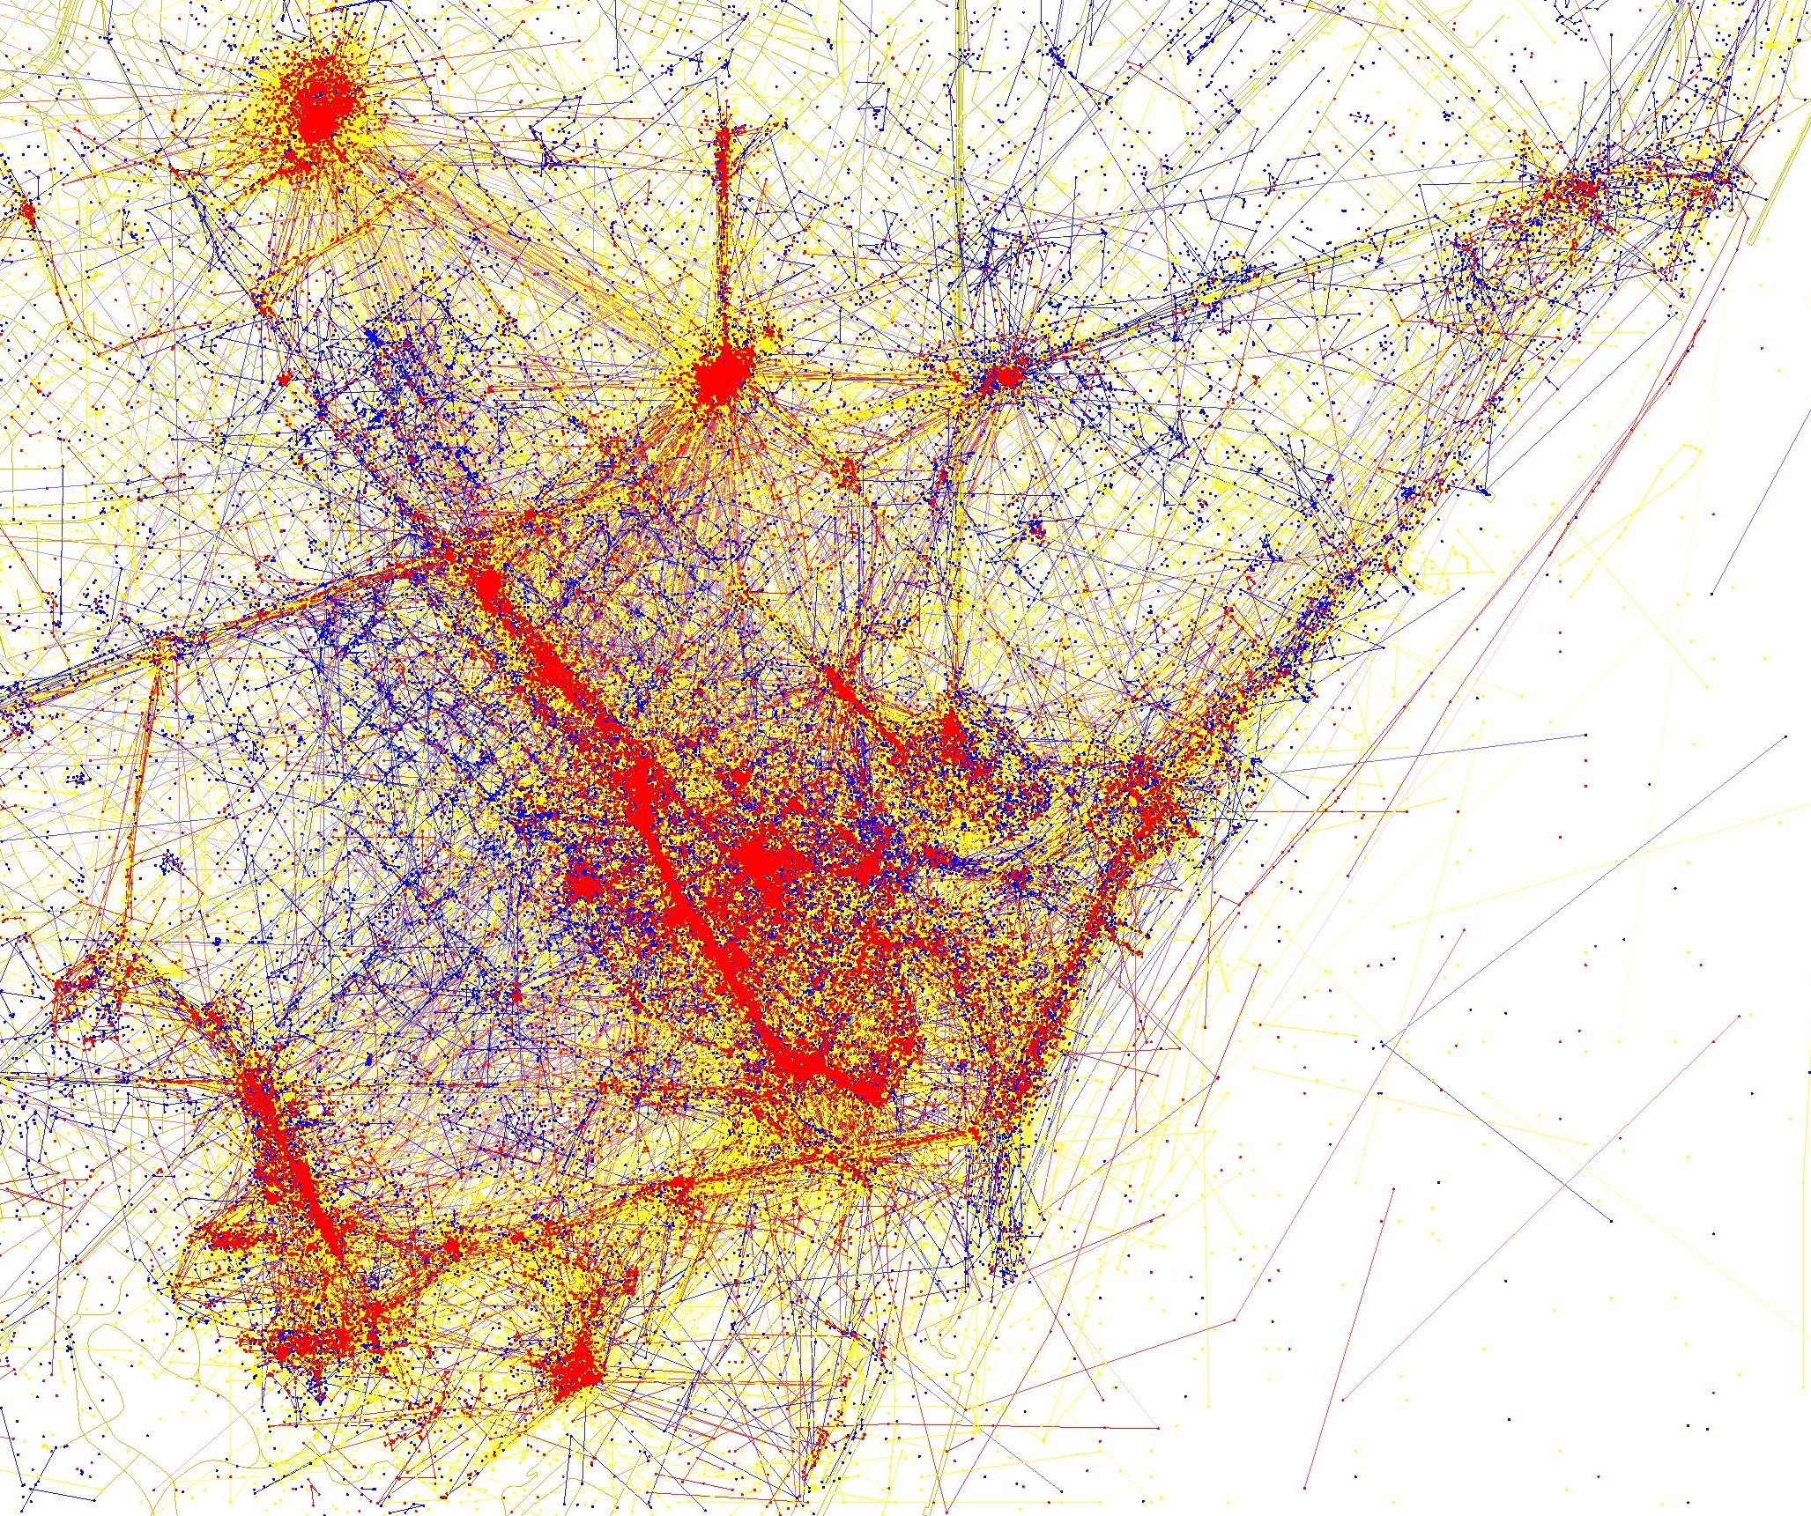
Tourist vs locals in Barcelona. Shows. Blue photos (Flickr) live in the city, red are tourists, yellow are unknown. Eric Fischer again
More details:
https://lotteharmsen.wordpress.com/tag/eric-fischer/

Slide 10
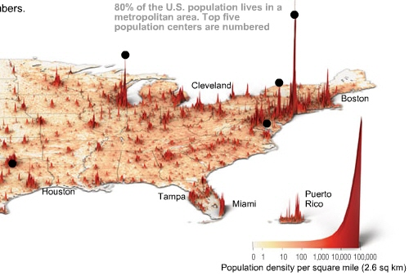
Time Magazine
http://content.time.com/time/interactive/0,31813,1549966,00.html

Slide 11
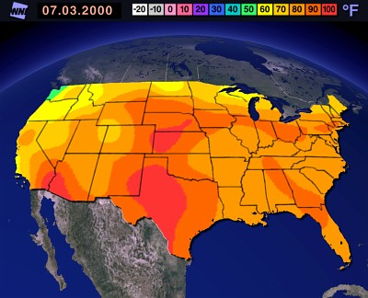
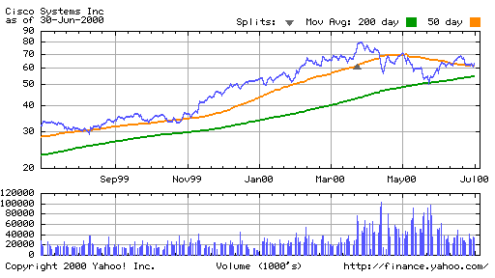
Small Data?

Slide 12
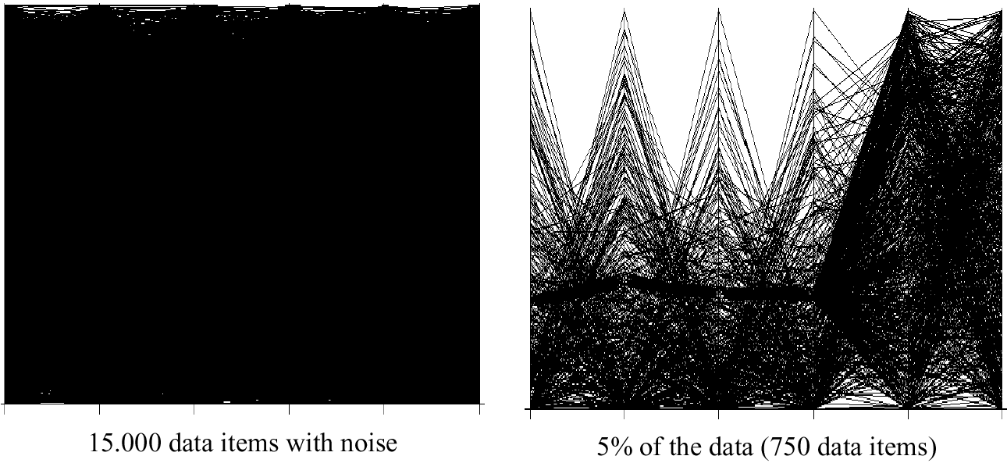
Visualization Techniques for Big Data

Slide 13
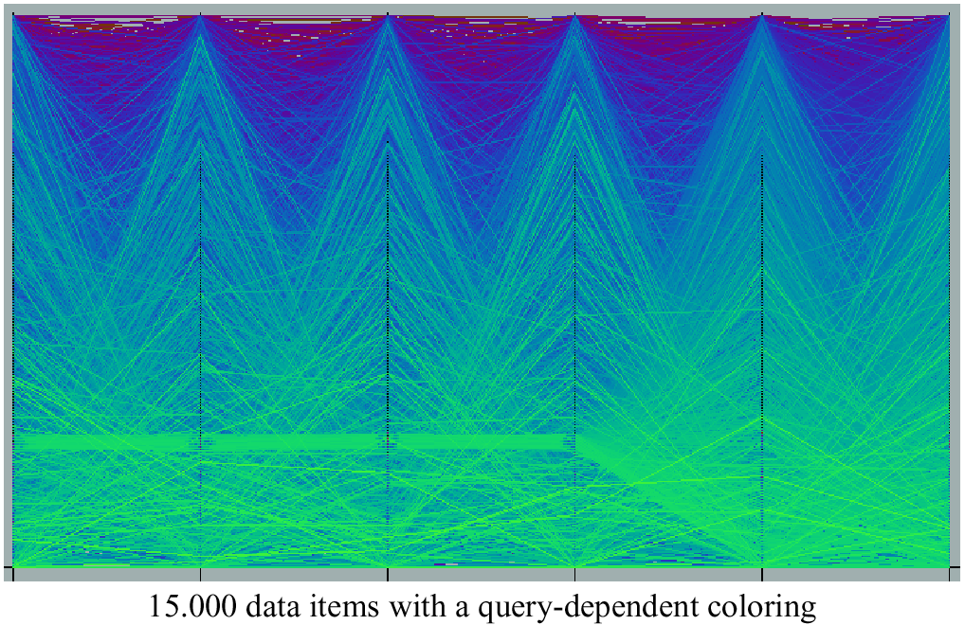
Query Dependent Coloring

Slide 14
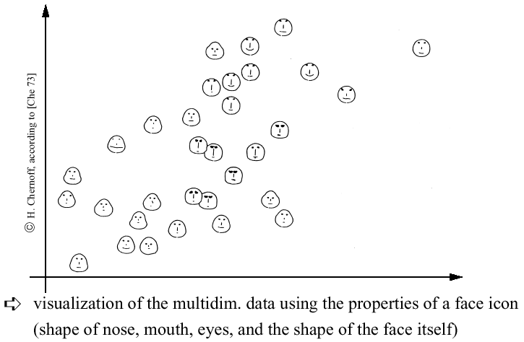
Chernoff-faces

Slide 15
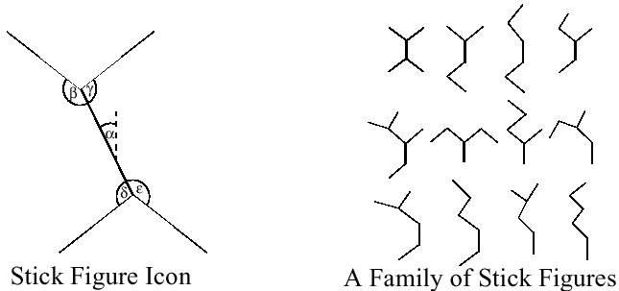
Stick Figures
Notes:
Visualization of the multidimensional data using stick figure icons
Two attributes of the data are mapped to the display axes and the remaining at-tributes are mapped to the angle and/or length of the limbs
Texture patterns in the visualization show certain data characteristics

Slide 16
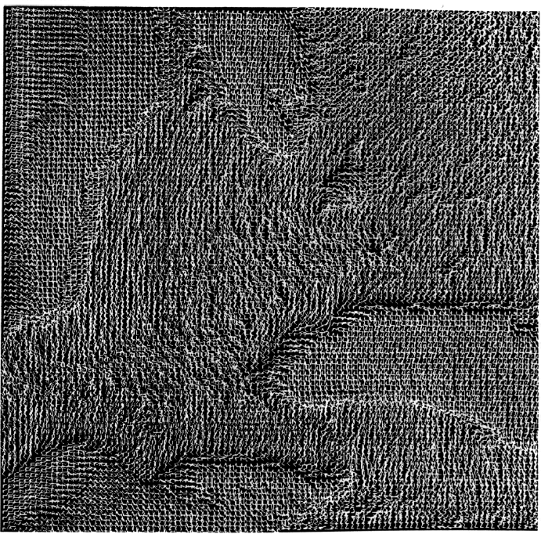
Stick Figures

Slide 17
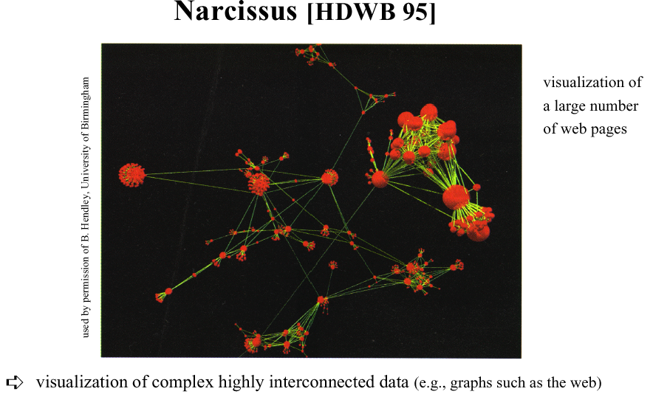
Graph-based Techniques

Slide 18
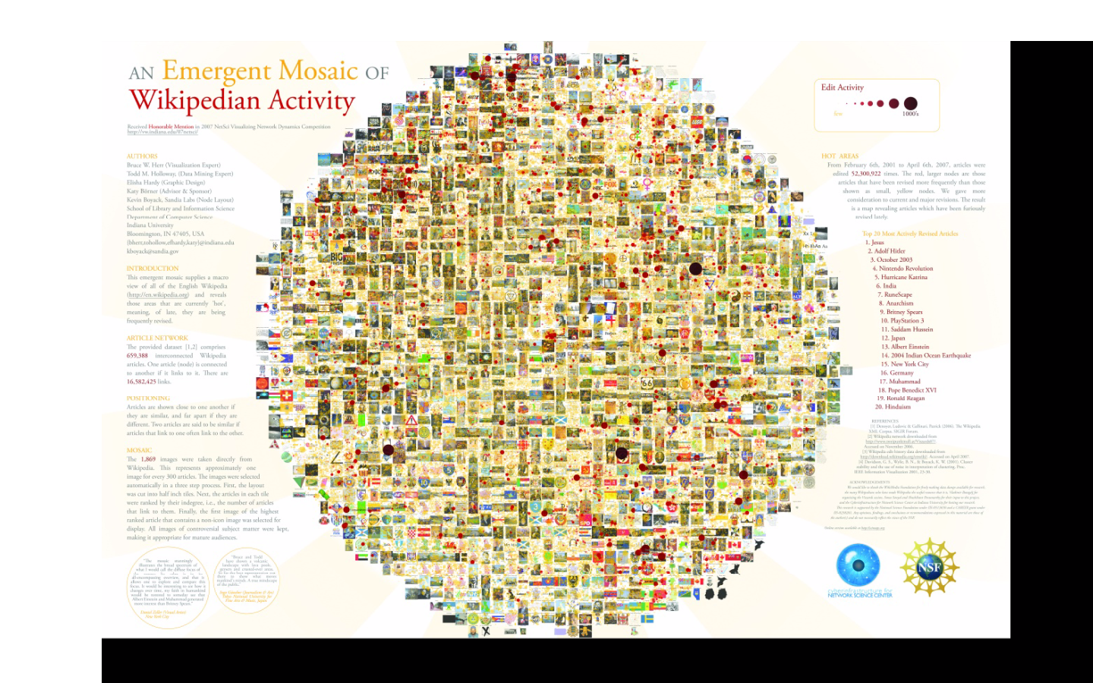
Zoomable UIs
http://gigapan.com/gigapans/4304
Notes:
he sizes of the nodes (circles, dots, whatever you want to call them), are based on a model of revision activity. So large circles indicate that an article might be controversial, or the subject of lots of vandalism, or just a topic whose content frequently changes.

Slide 19
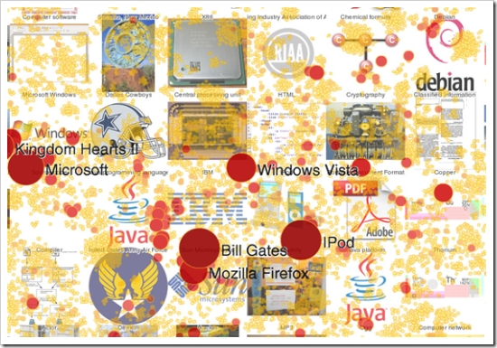
Zoomable UIs
http://gigapan.com/gigapans/4304
Notes:
he sizes of the nodes (circles, dots, whatever you want to call them), are based on a model of revision activity. So large circles indicate that an article might be controversial, or the subject of lots of vandalism, or just a topic whose content frequently changes.

Slide 20
Distortion Techniques
Basic Idea: Distortion of the image to allow a visualization of larger amounts of data
An alternative to zoomable Uis (or complement)

Slide 21
Distortion Techniques
Basic Idea: Distortion of the image to allow a visualization of larger amounts of data
Simple:
Perspective Wall [MRC91]
Bifocal Displays [SA 82]
TableLens [RC94]
Graph. Fisheye Views [Fur 86, SB94]
Hyperbolic Repr. [LR94, LRP95]
Complex:
Hyperbolic Repr. [LR94, LRP95]
3D-Hyperbolic Repr. [MB95]
Hyperbox [AC91]

Slide 22
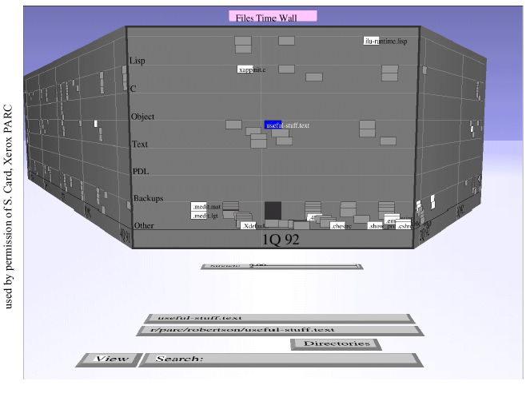
Perspective Wall
Notes:
Presentation of the data on a perspective wall
The data outside the focal area are perspectively reduced in size
The perspective wall is a variant of the bifocal lens
Display [SA82] which horizontally compresses the sides of the workspace by direct scaling

Slide 23
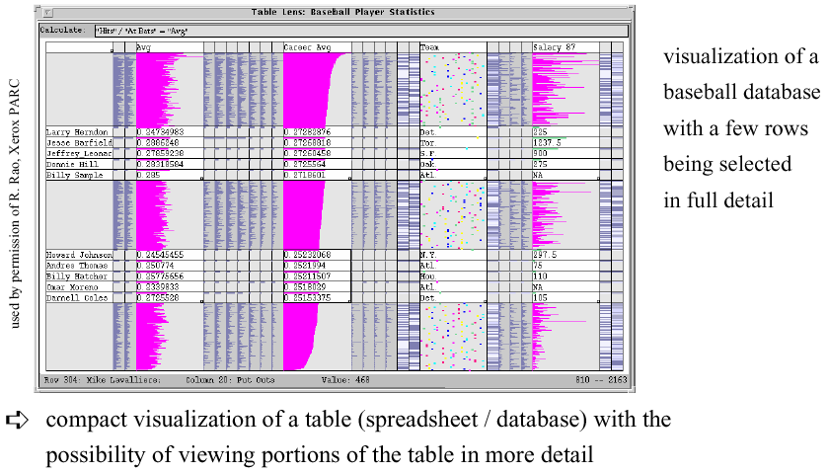
Table Lens

Slide 24
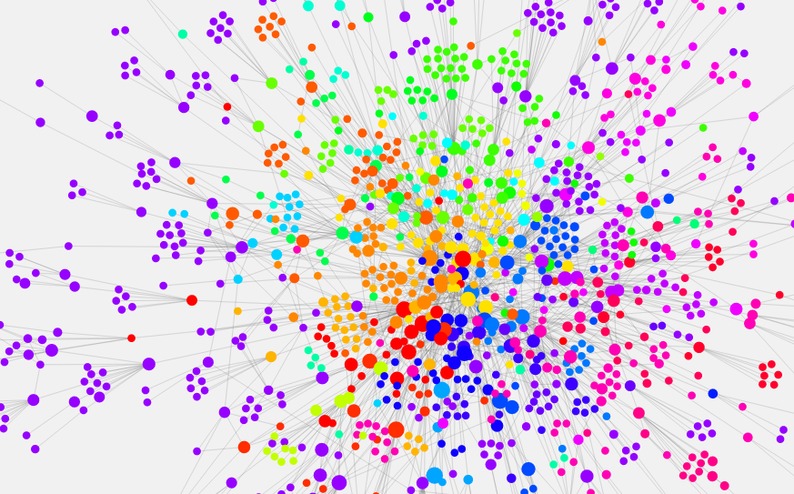
Networks of Information
http://www.designandanalytics.com/philosophers-graph/
Notes:
[a topic for byte 6]

Slide 25
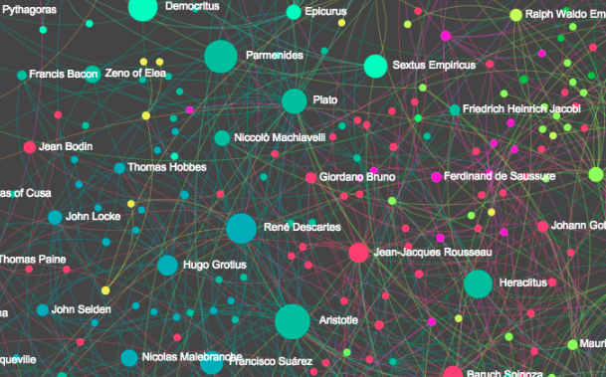
Networks of Information – with zooming
http://www.designandanalytics.com/philosophers-gephi/

Slide 26
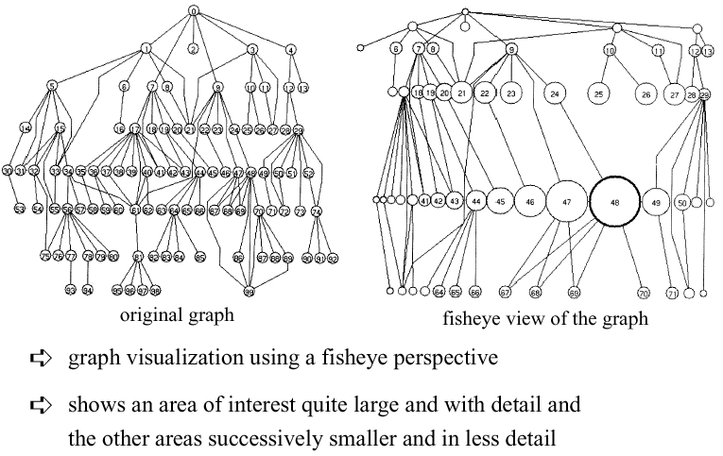
Fisheye View

Slide 27
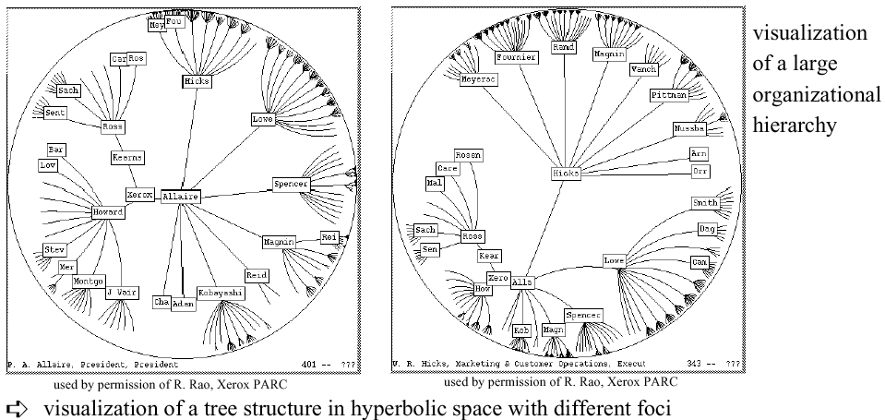
Hyperbolic Tree

Slide 28
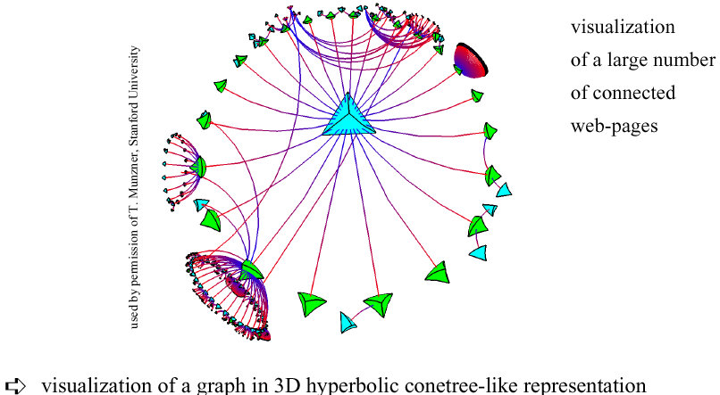
3D Hyperbolic Representation

Slide 29

Magic Lenses/Moveable Filter
interactive selection using lens-like tools which selectively filter the data in the considered areas
multiple lenses/moveable filters can be used for a multi-level filtering (allowing complex conditions)

Slide 30
TreeMap (Johnson & Shneiderman ’91)
The TreeMap Idea:
Show a hierarchy as a 2D layout
Fill up the space with rectangles representing objects
Size on screen indicates relative size of underlying objects.

Slide 31
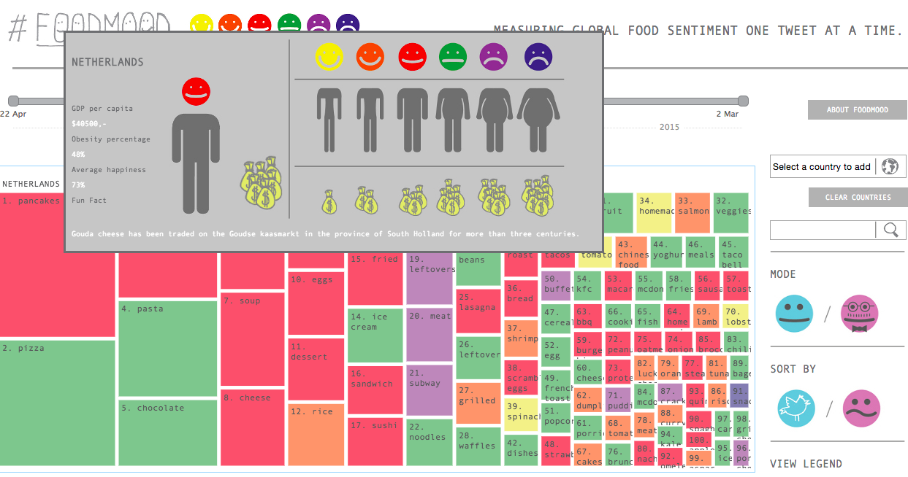
Treemap
http://foodmood.in/
Notes:
XX UPDATE – bad example, doesn’t seem to have any hierarchy!

Slide 32
Successful Application of Treemaps
Think about the use (analysis vs comunication)
Break into meaningful groups
Fix these into a useful aspect ratio
Use visual properties properly
Use color to distinguish meaningfully
Use only two colors:
Can then distinguish one thing from another
When exact numbers aren’t very important
Provide excellent interactivity
Access to the real data
Makes it into a useful tool

Slide 33
Further Reading
Big Data Issues in Climate Science
http://online.liebertpub.com/doi/full/10.1089/big.2014.0026
“Every dataset has a story, and understanding it can guide the choice of suitable analyses; some have labeled this data understanding as data empathy.”
Big Data and Health
http://online.liebertpub.com/doi/full/10.1089/big.2013.0029
“Big Data, Justice & Power… it is dangerous to think that big data, including that large-scale data can be made anonymous, are inherently objective and include tacit or explicit consent or an opt-out function.”
Notes:
‘data empathy

Slide 34
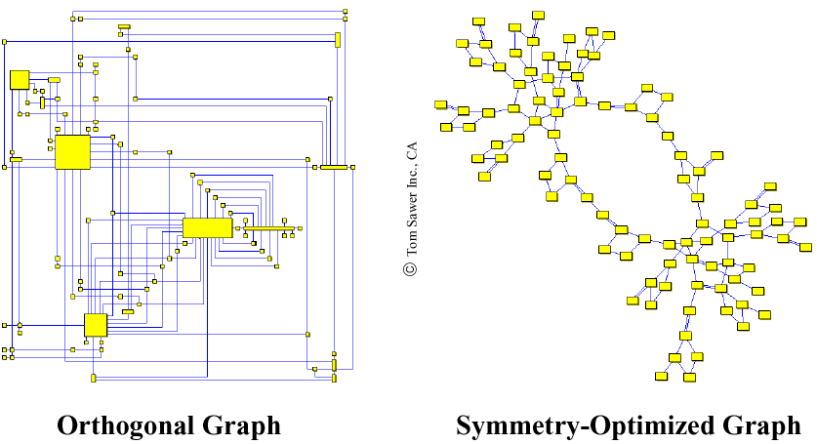
2D Graph Examples

Slide 35
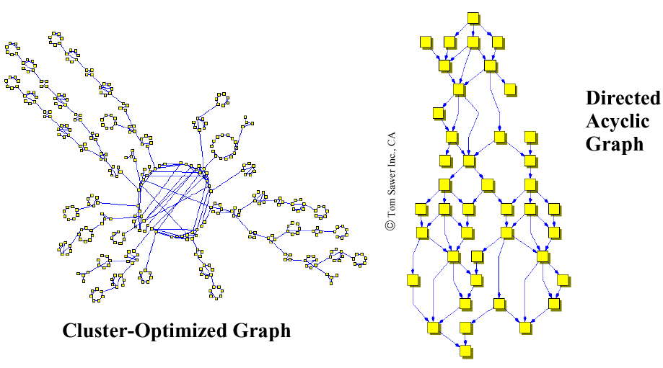
2D Graph Examples
Notes:
With Distortion
Properties of 2D-Graph Drawings
planarity (no line crossings)
orthogonality (only orthogonal lines)
grid property (coordinates of vertices are integers)
Aesthetics Properties (Optimization Goals)
minimal number of line crossings
optimal display of symmetries
optimal display of clusters
minimal number of bends in polyline graphs
uniform distribution of vertices
uniform edge lengths

Slide 36
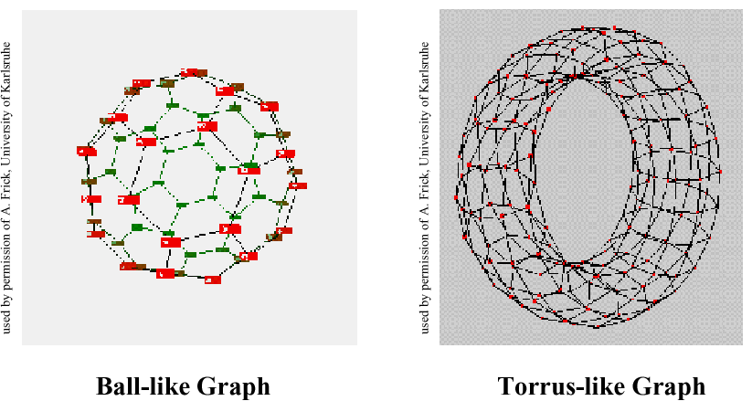
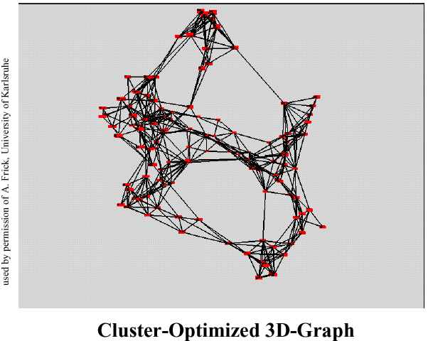
3D-Graph Drawing

Slide 37
Summary
Make use of every pixel
Use color and location to break the data up and allow the viewer to easily filter
Give a sense of things and use zooming for detail
Add a dimension such as time or height for a key variable
Allow exploration through distortion, filtering, highlighting, and linking
Exploit hierarchy and connectivity

